Slide 1
Ads Optimization with Facial emotion recognition Deep Learning
Quoc Tuong Lukas Dong
Vignesh Thanigai Sivabalan

Slide 2
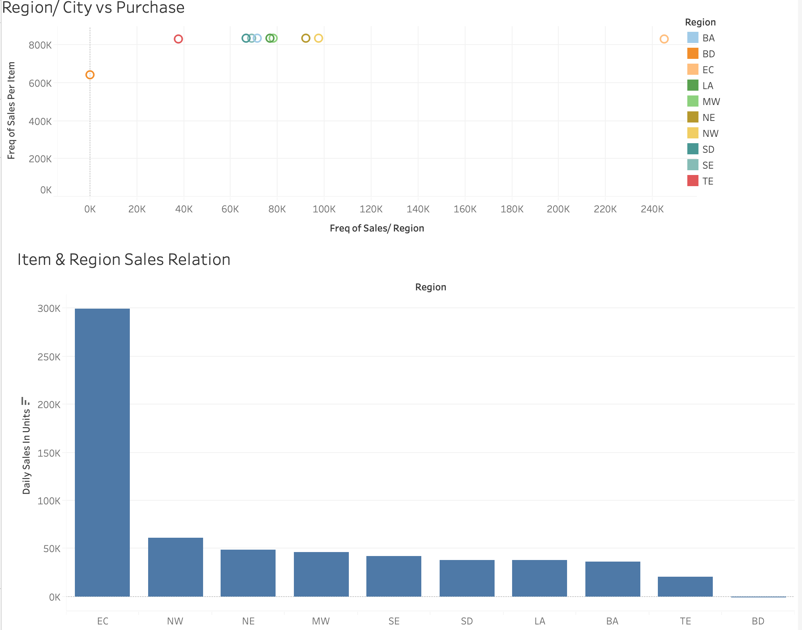

Slide 3
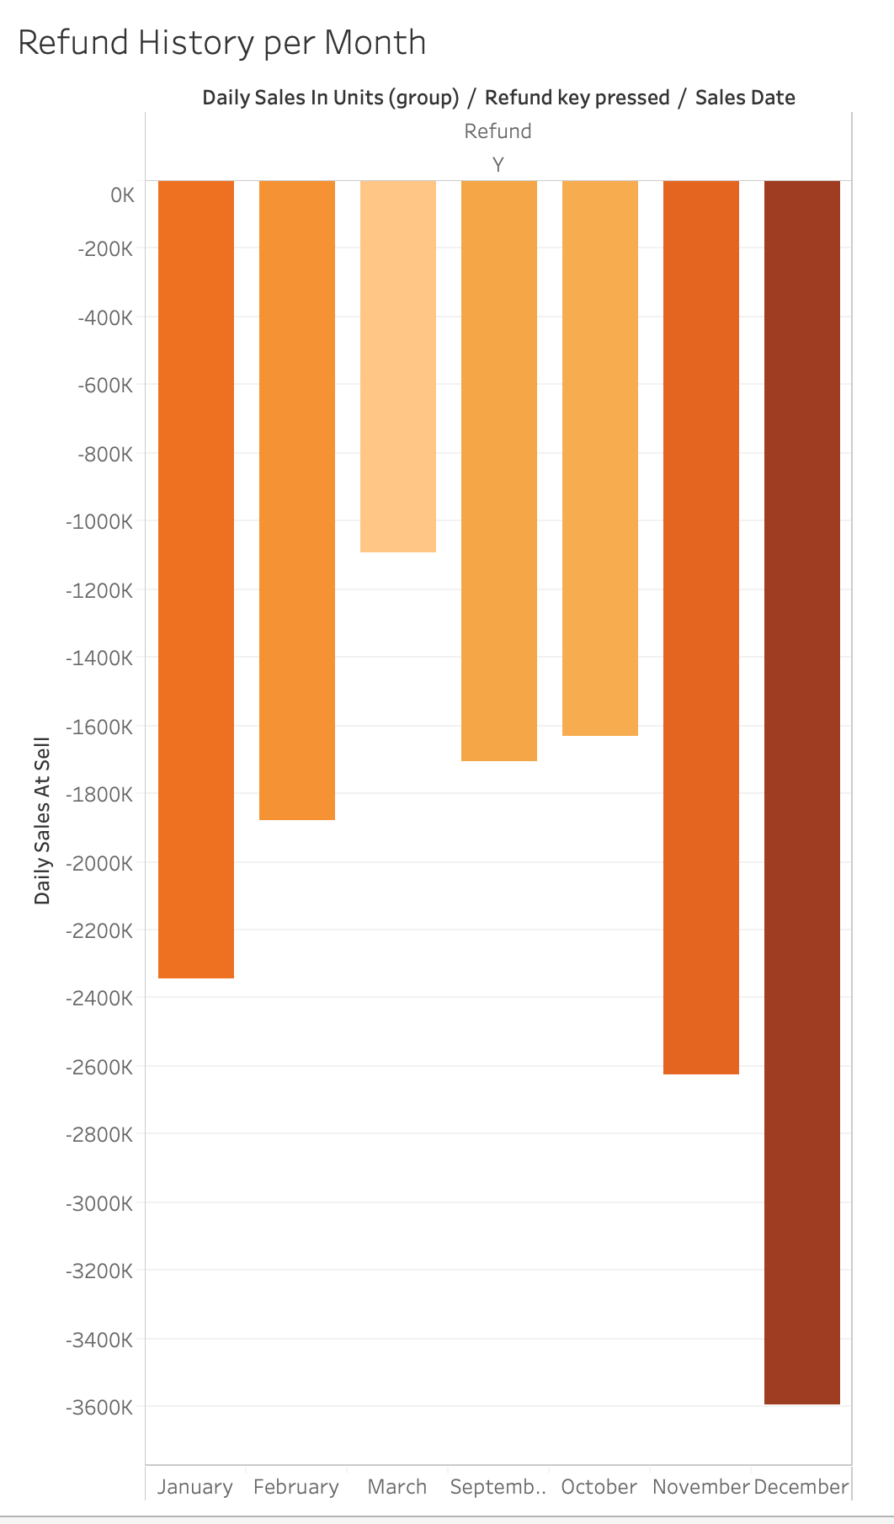
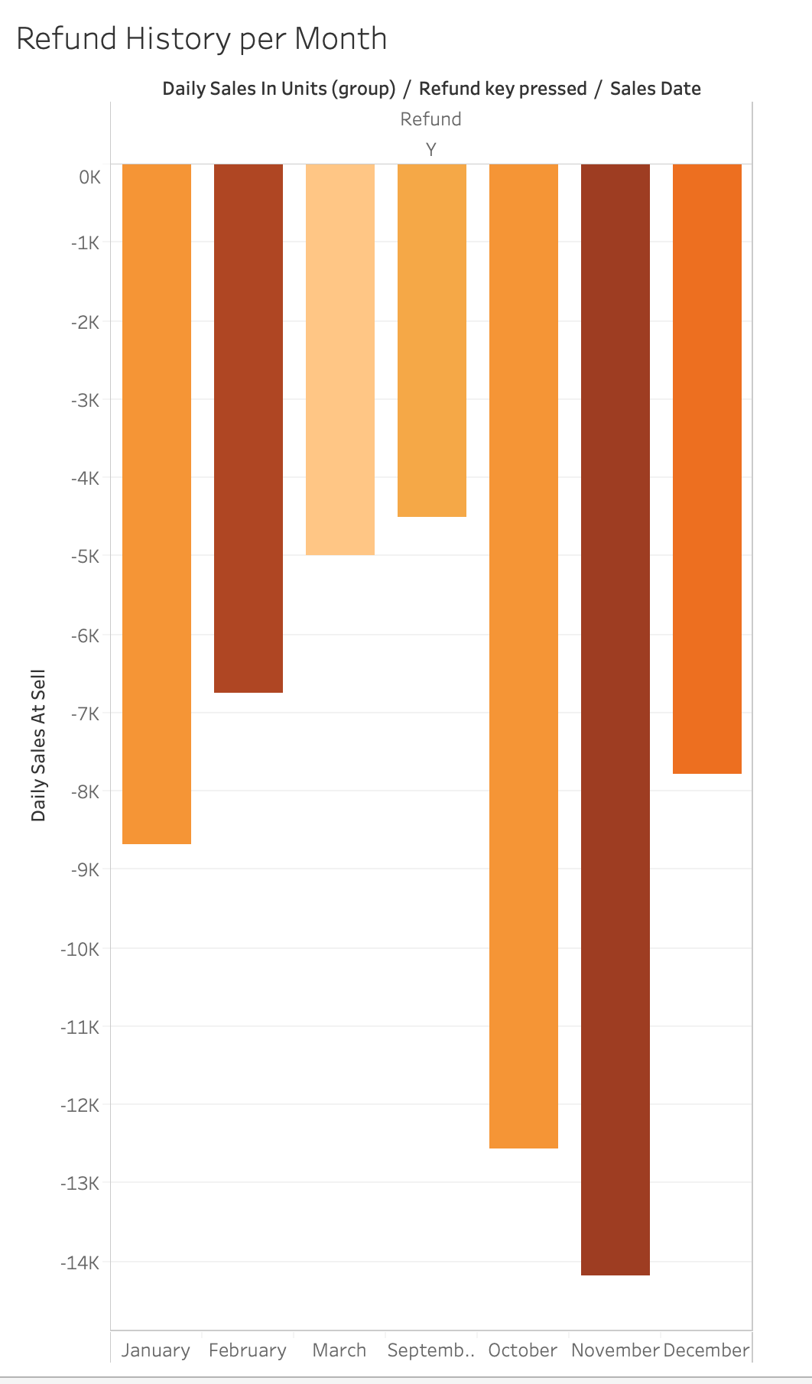

Slide 4
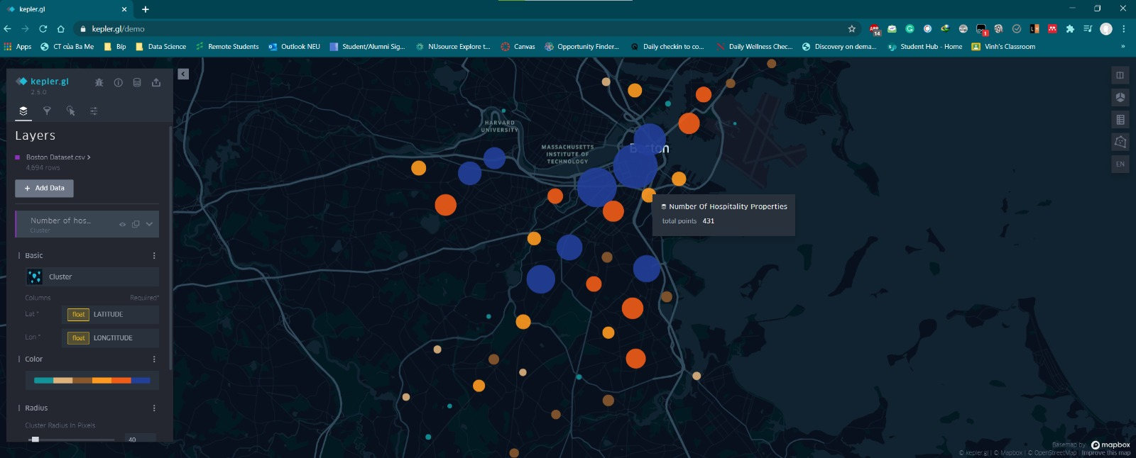
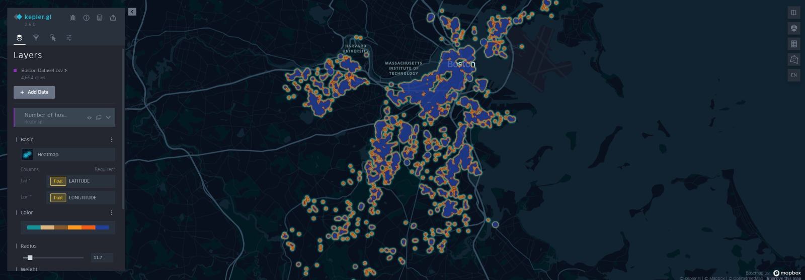

Slide 5
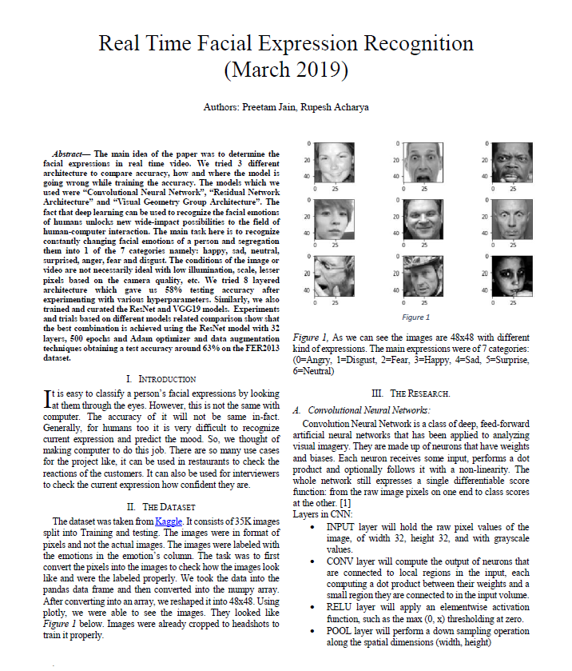
Inspired by the Real Time facial Expression Recognition paper (Preetam Jan and Rupesh Acharya- NEU’s alumni)
Building three different Facial Emotion Recognition models and decide the best model.
CNN: Convolutional Neural Network Visual
VGG19: Geometry Group Architecture
ResNet: Residual Network Architecture

Slide 6
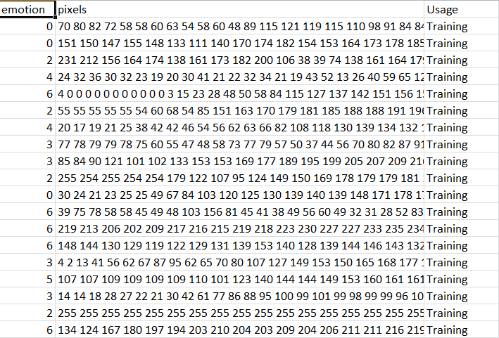

Slide 7
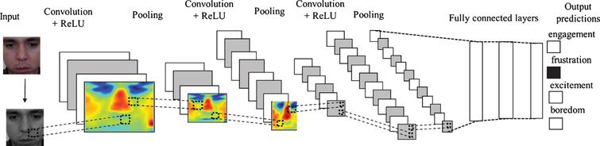
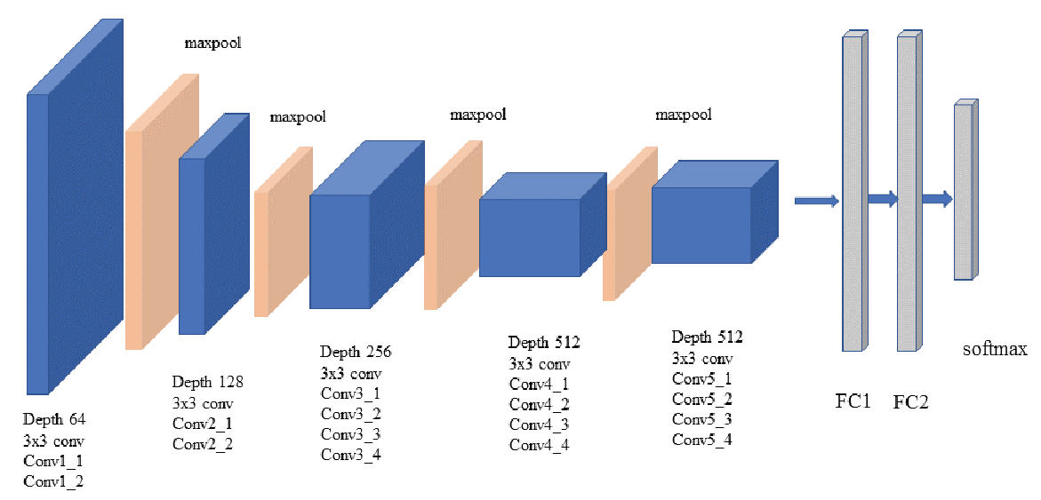
CNN:
VGG19:

Slide 8
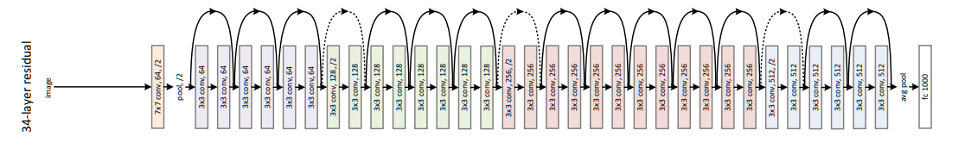
ResNet (34 layers):
Coding steps
Converting lines to array as the lines representing pixels
Creating the train/Test Set
Converting our training variables to NP array
Normalizing inputs between [0,1]
Reshaping the array to 48*48
Constructing models and generate batch of tensor image data with real time data augmentation
Create the function to read the emotion and apply it to the picture

Slide 9
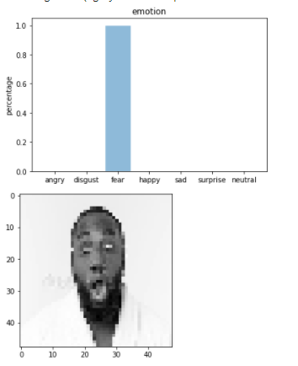


Slide 10
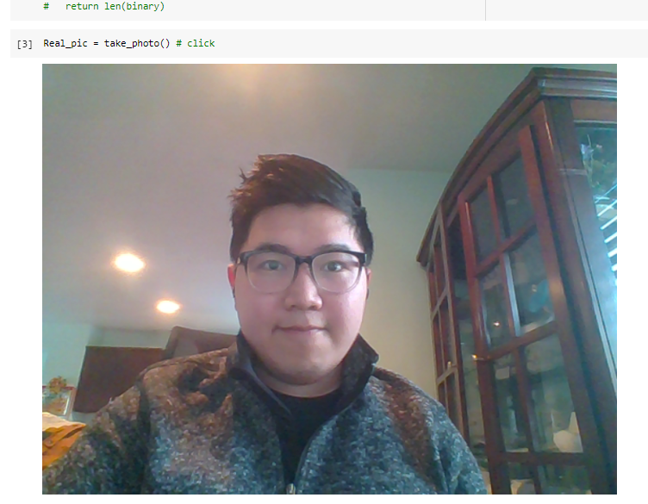
 | Test Set Accuracy rate
CNN | 57.62%
VGG19 | 59.26%
ResNET | 63% (from previous report)

Slide 11
THANK YOU!
Do you have any questions?

